Slide 1
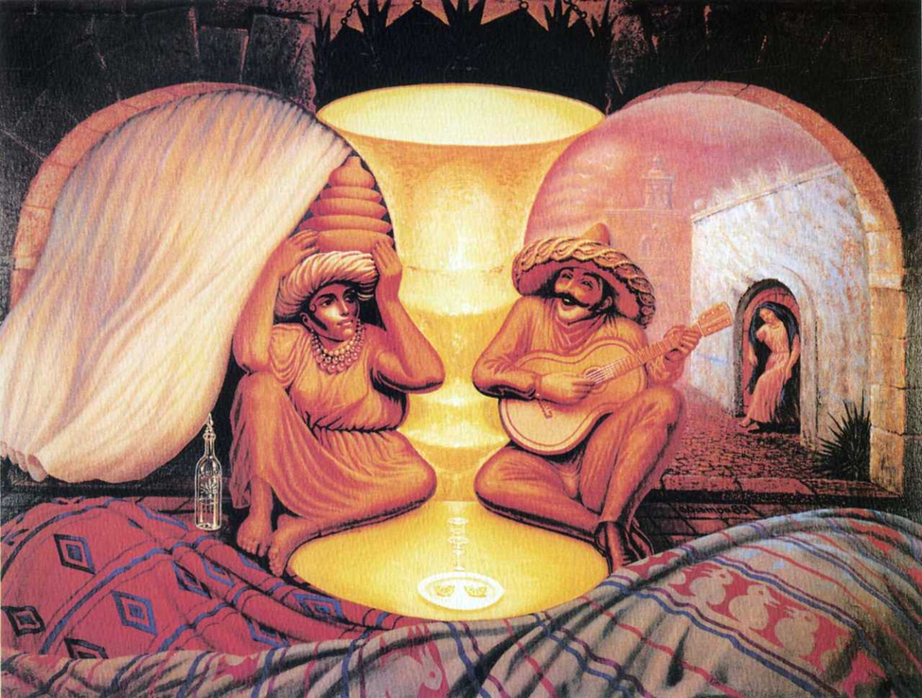

Slide 2
The miracle of illusion

Slide 3
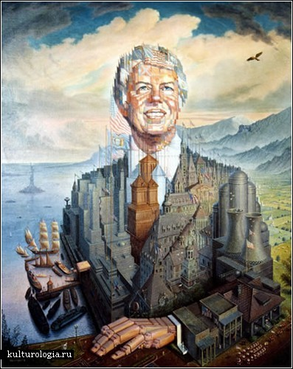
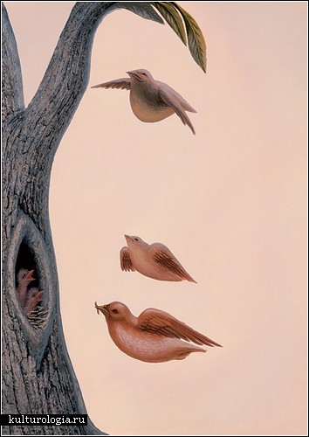
Purpose: describe the picture, understand illussion

Slide 4
Tasks:
Read about the author
Learn new words
Learn how to describe the picture
Describe the picture

Slide 5
Vocabulary
In the foreground – на переднем плане
find hidden images – найти спрятанные образы
is filled with symbols –наполнен символами
endless meanings – бесконечные значения
various contents and associations –различное содержание и ассоциации
nature is often humanized –природа олицетворяется
images of people appear through – образы людей проявляются через

Slide 6
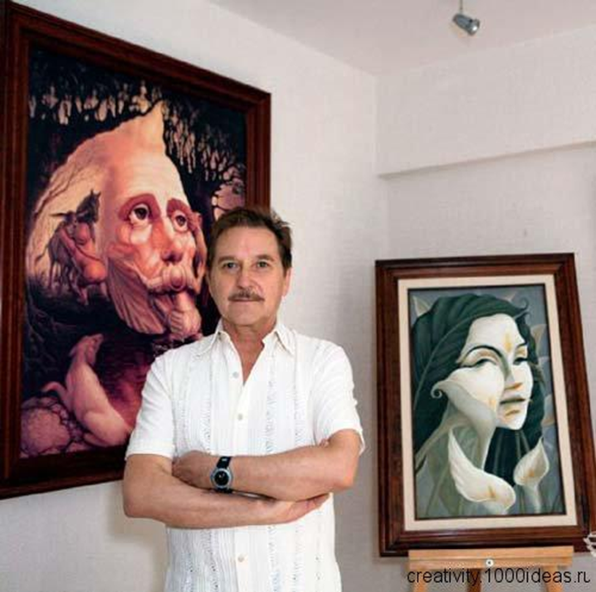
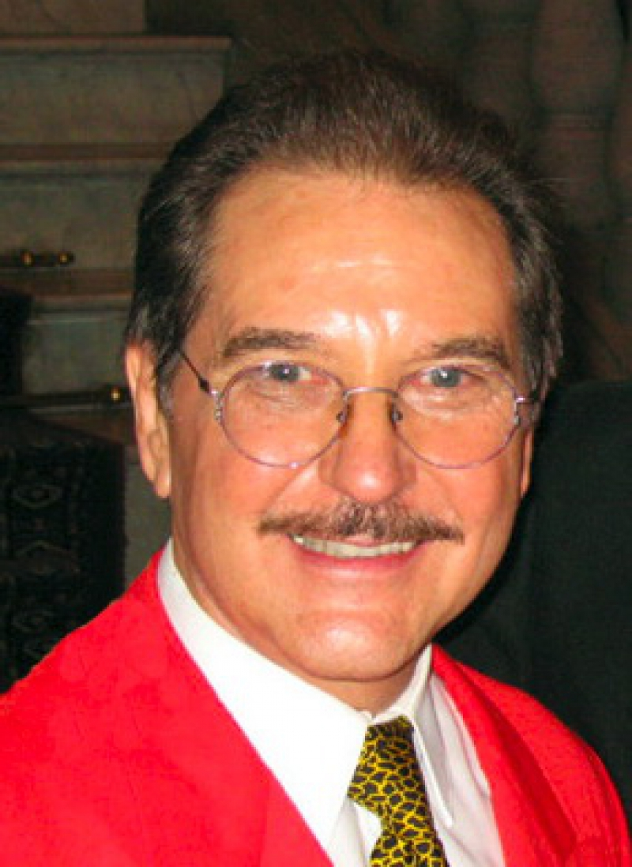
Octavio Ocampo

Slide 7
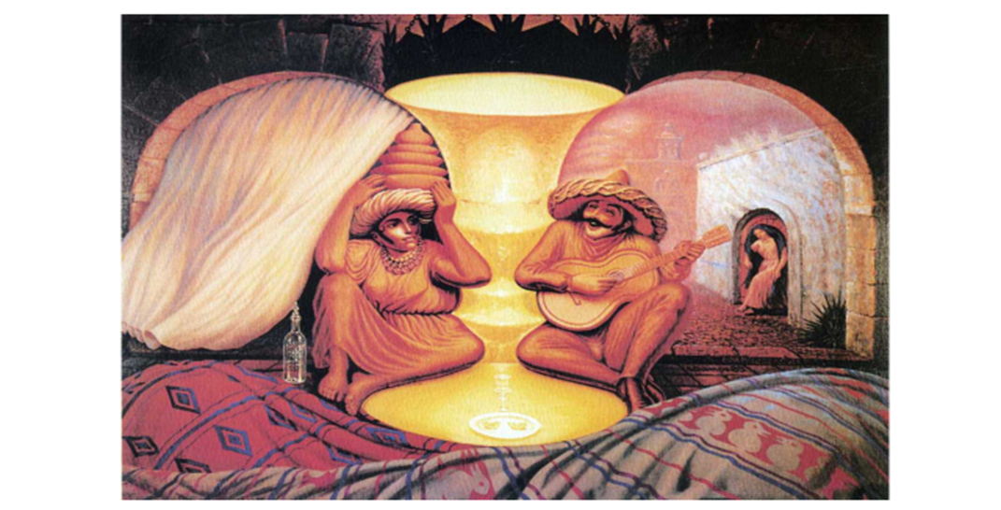
Description
The name of the painting is____________.
It is painted by__________
It can/can’t be very old.
It shows__________
In the foreground we can see_______
They are __________________.
The more time we consider the work/look at the picture the more details we can see.
In this picture I can see_________.
They might symbolize__________.
The colours are _______.
I like the picture because it makes me think about…/feel happy/relaxed.

Slide 8
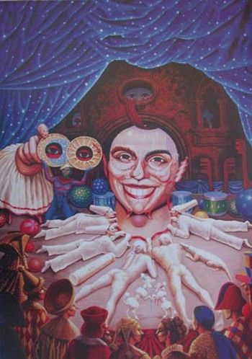
Results
16-14 –Excellent! You can work in the
picture gallery!
13-10 - Good job! But you seem not to like illusions,
you live in the real world)
9-6 – Art is not your cup of tea!
Making selfie is more exciting!

